Slide 1




Observational Medical Outcomes Partnership Common Data Model for EHR Data (OMOP-CDM)
COMP5400: Hybrid and Relational Databases
Yina Hou, Ibna Kowsar
Department of Computer Science
Tennessee State University
yhou@tnstate.edu, ikowsar@tnstate.edu
https://github.com/kawseribn/COMP5400_Project.git
Aprill 22, 2024

Slide 2
Outline
Motivation
Database Design
Implementation
Data Manipulation
Results
Challenges
Conclusions
References

Slide 3

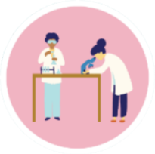

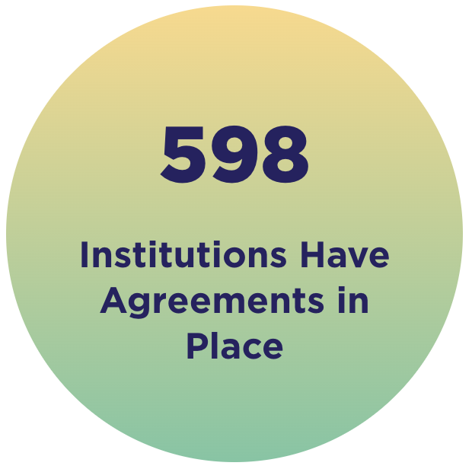
Motivation
Know the risk factors for certain diseases
Investigate treatments that work best for people of different backgrounds
Professionals can retrieve specific subsets of data from the database (i.e., Deep imputation in time series data [1])
10,100
Health Researchers
Strict security protocols and processes -> ensure data are protected
+

Slide 4
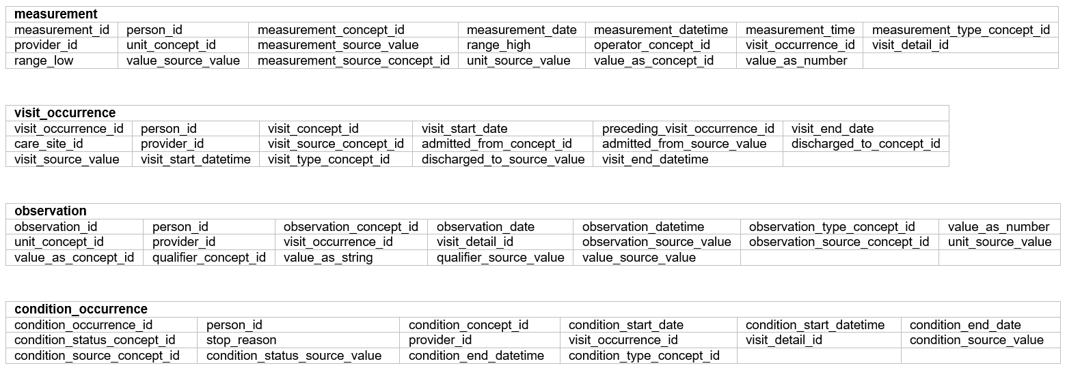
Database design — Schema

Slide 5
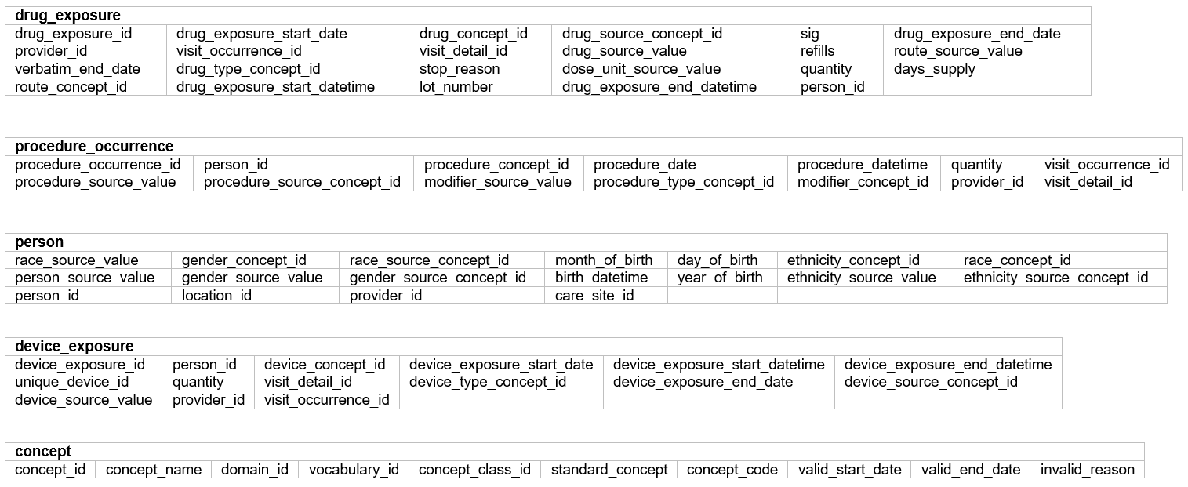
Database design — Schema

Slide 6
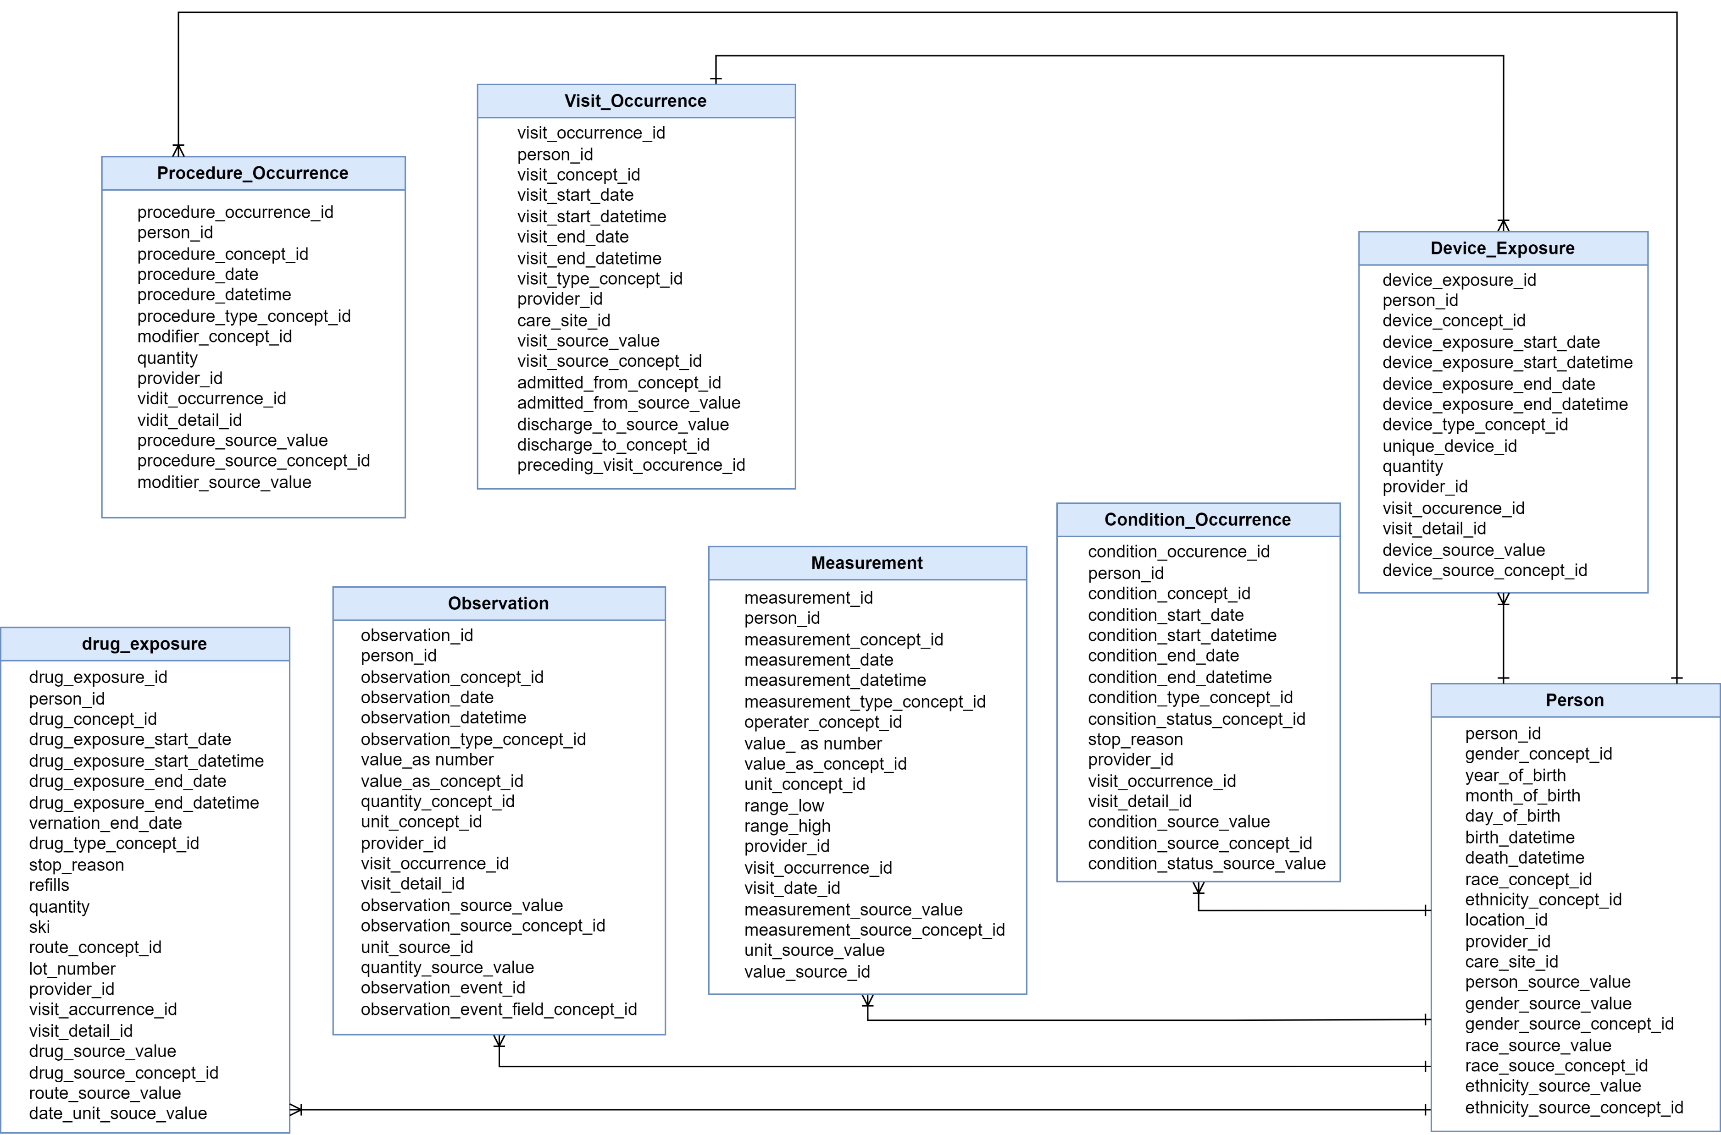
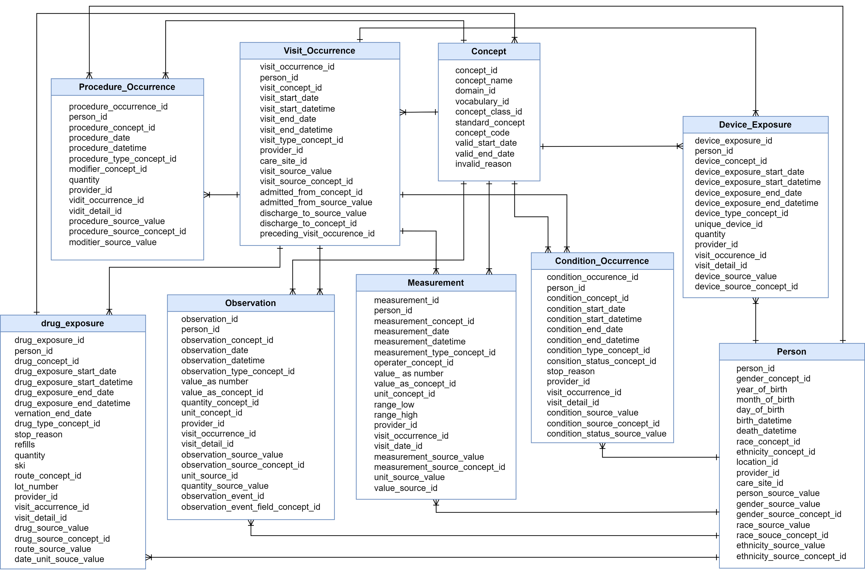
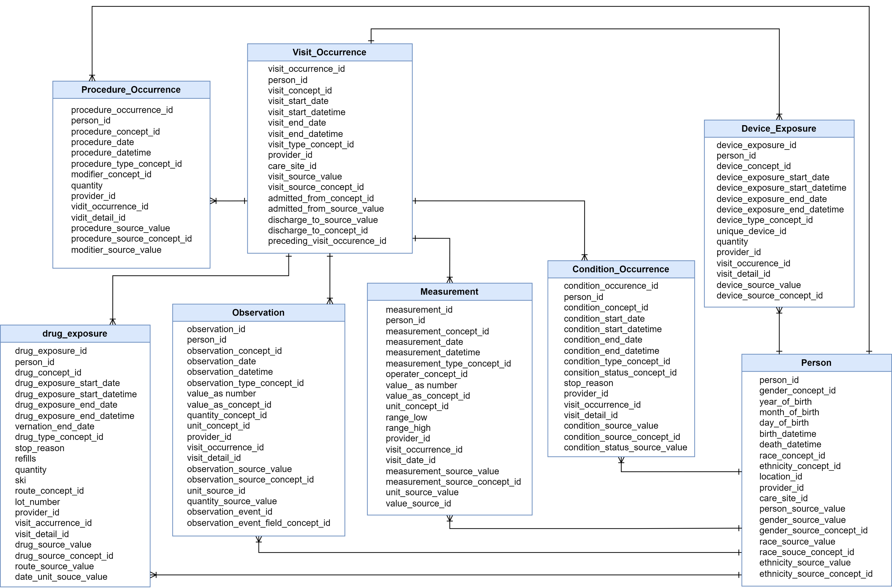
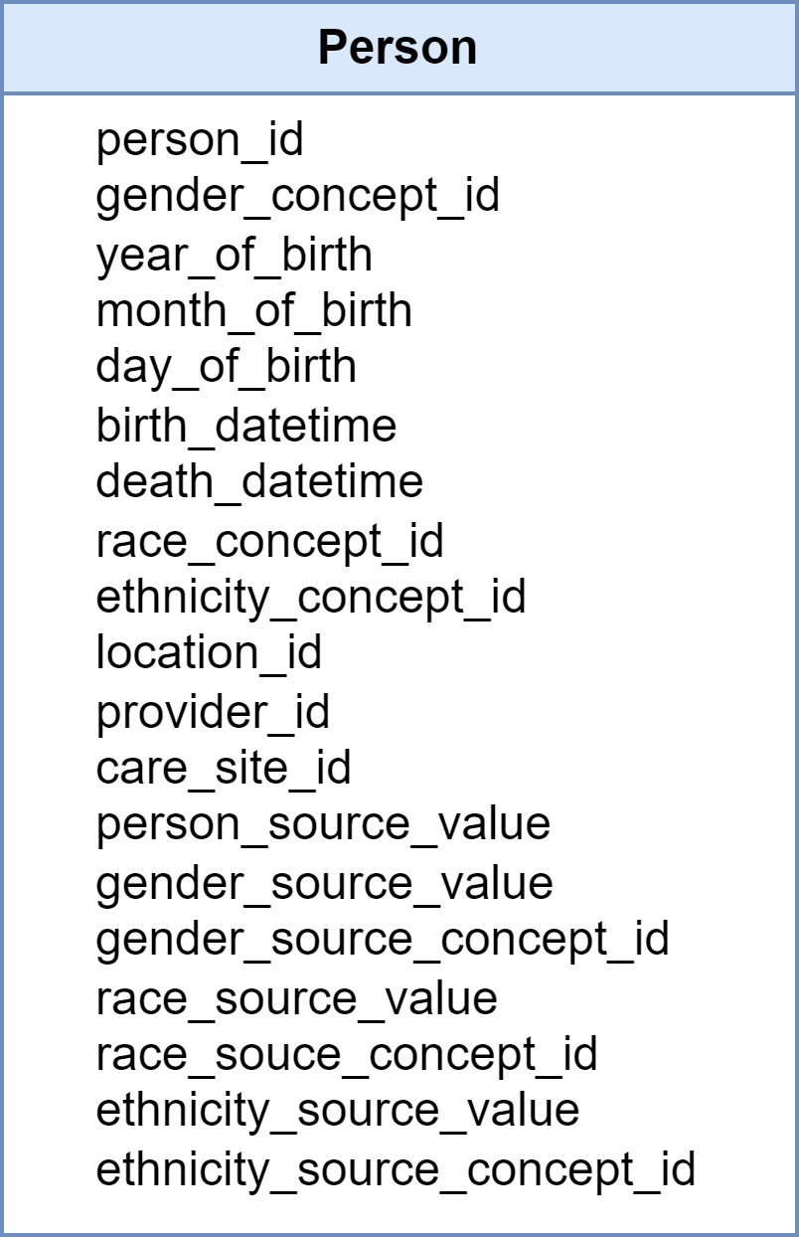
Database design – Entity Relationship

Slide 7

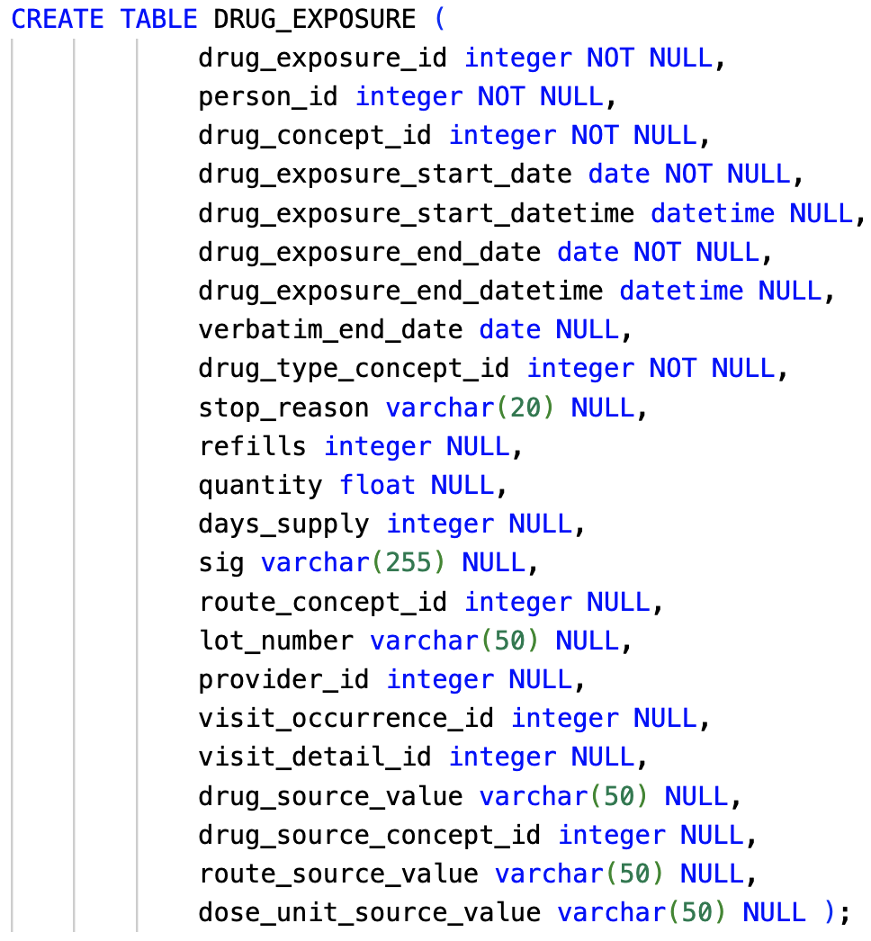
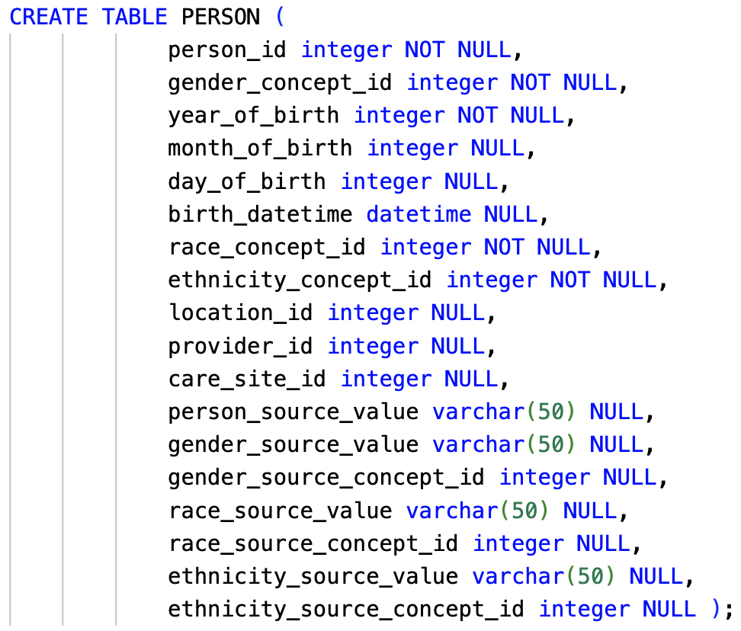
Implementation – DDL
Drug Exposure Table
Person Table

Slide 8
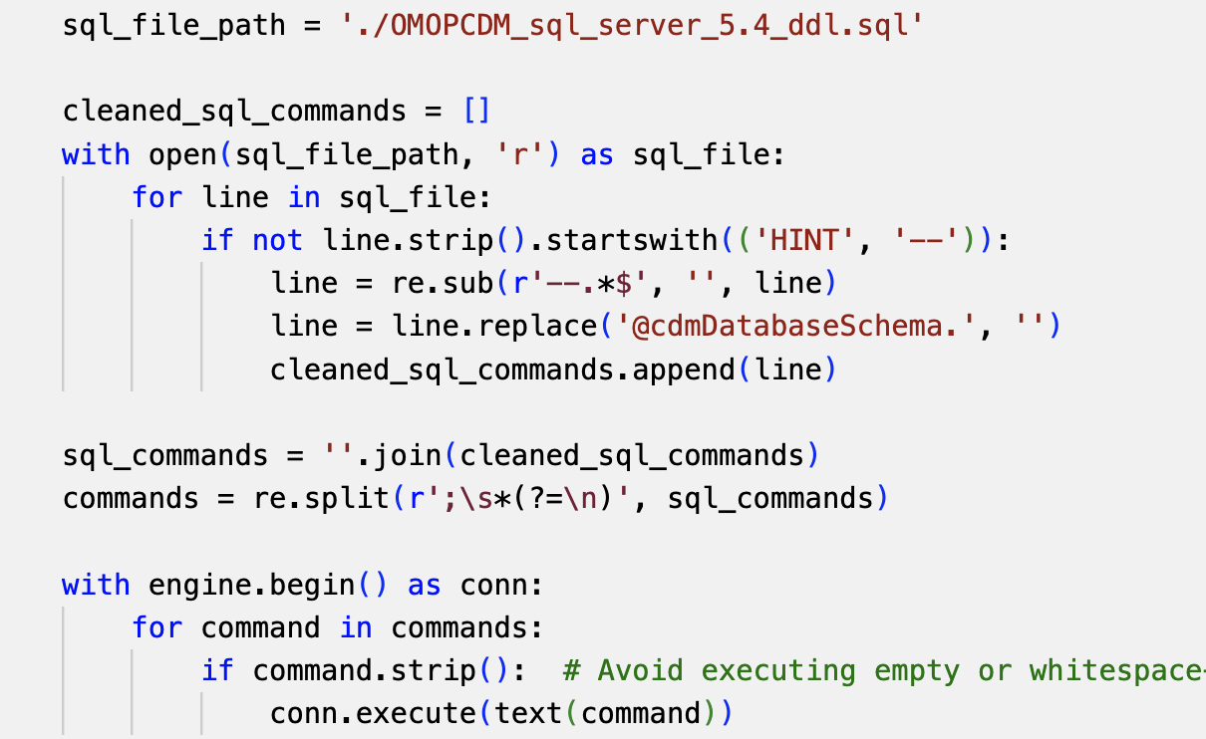
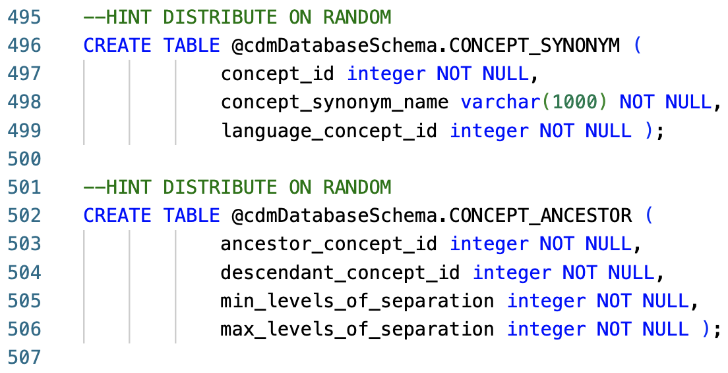
Implementation – SQL to MySQL

Slide 9
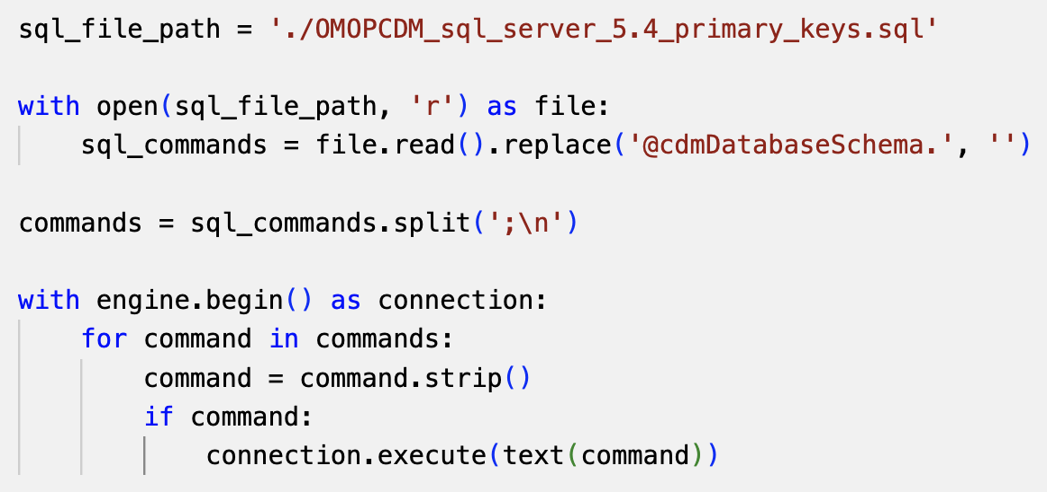
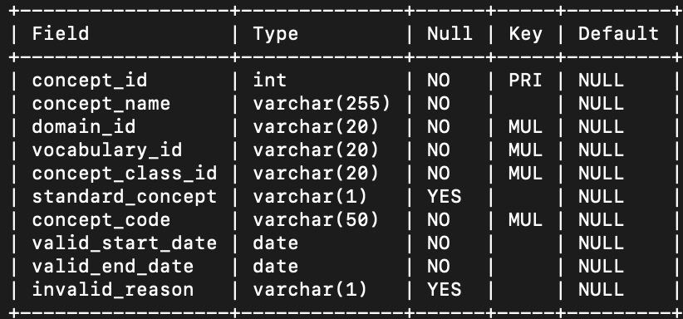
Implementation – Key Constraints
Update Constraints
Output table
ALTER TABLE @cdmDatabaseSchema.PERSON ADD CONSTRAINT xpk_PERSON PRIMARY KEY NONCLUSTERED (person_id);
ALTER TABLE@cdmDatabaseSchema.OBSERVATION_PERIOD ADD CONSTRAINT xpk_OBSERVATION_PERIOD PRIMARY KEY NONCLUSTERED (observation_period_id);
ALTER TABLE @cdmDatabaseSchema.VISIT_OCCURRENCE ADD CONSTRAINT xpk_VISIT_OCCURRENCE PRIMARY KEY NONCLUSTERED (visit_occurrence_id);
ALTER TABLE @cdmDatabaseSchema.CONCEPT ADD CONSTRAINT xpk_CONCEPT PRIMARY KEY NONCLUSTERED (concept_id);
ALTER TABLE @cdmDatabaseSchema.CONDITION_OCCURRENCE ADD CONSTRAINT xpk_CONDITION_OCCURRENCE PRIMARY KEY NONCLUSTERED (condition_occurrence_id);
ALTER TABLE @cdmDatabaseSchema.DRUG_EXPOSURE ADD CONSTRAINT xpk_DRUG_EXPOSURE PRIMARY KEY NONCLUSTERED (drug_exposure_id);

Slide 10
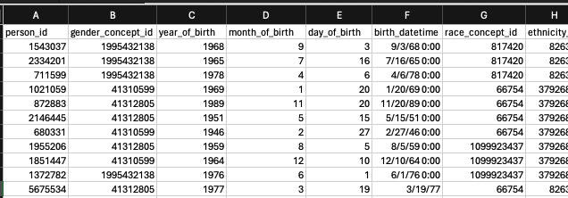
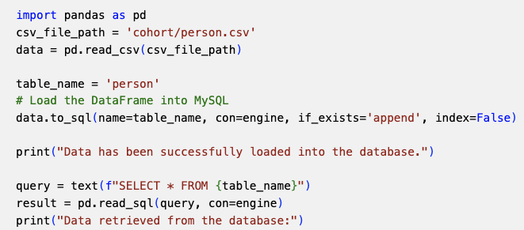
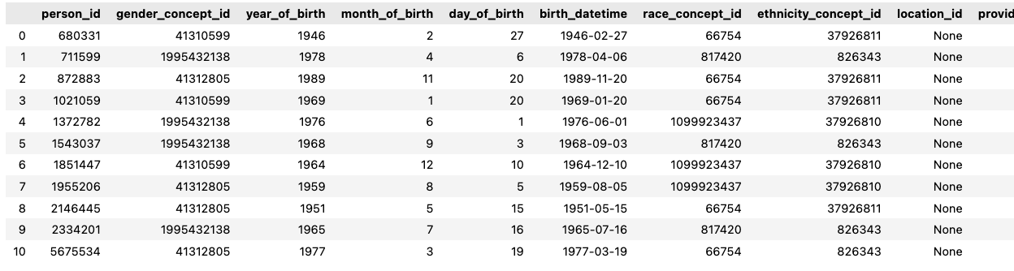
Implementation – DML

Slide 11

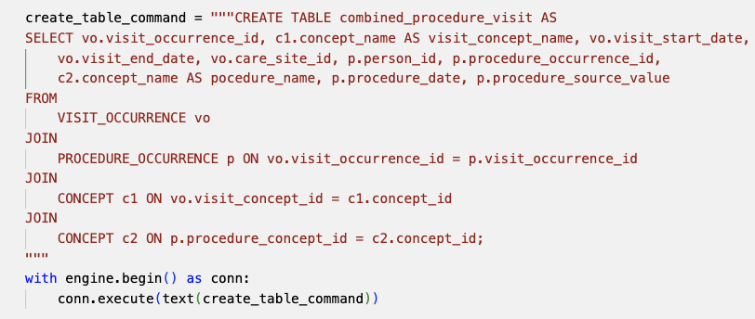
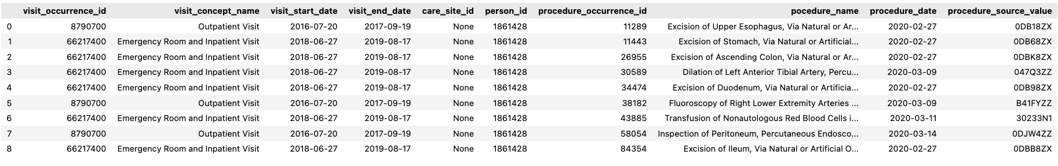
Implementation – DML

Slide 12
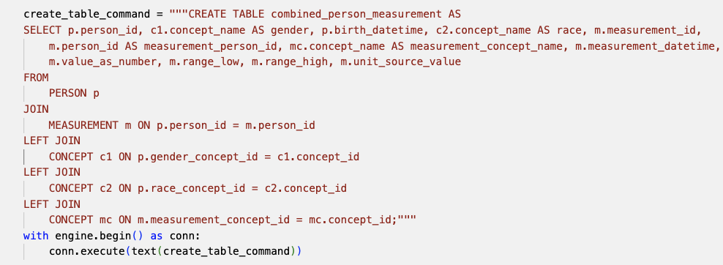


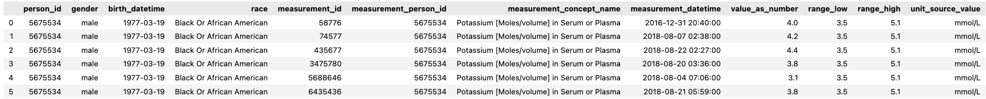
Implementation – DML

Slide 13
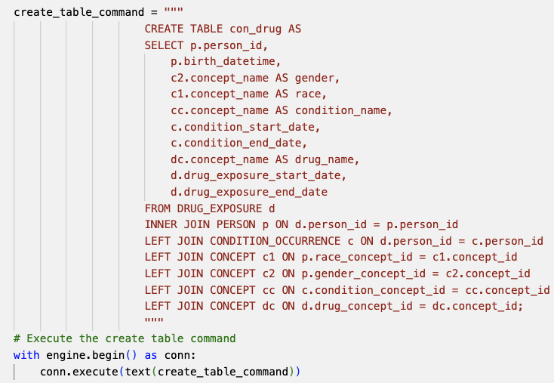
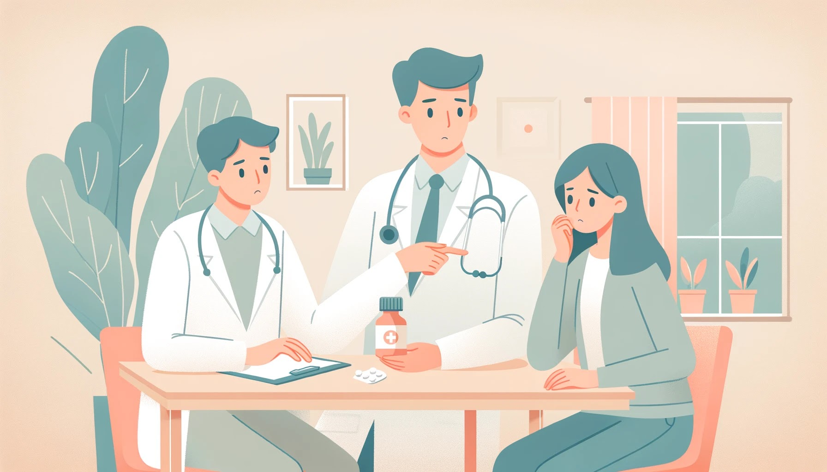
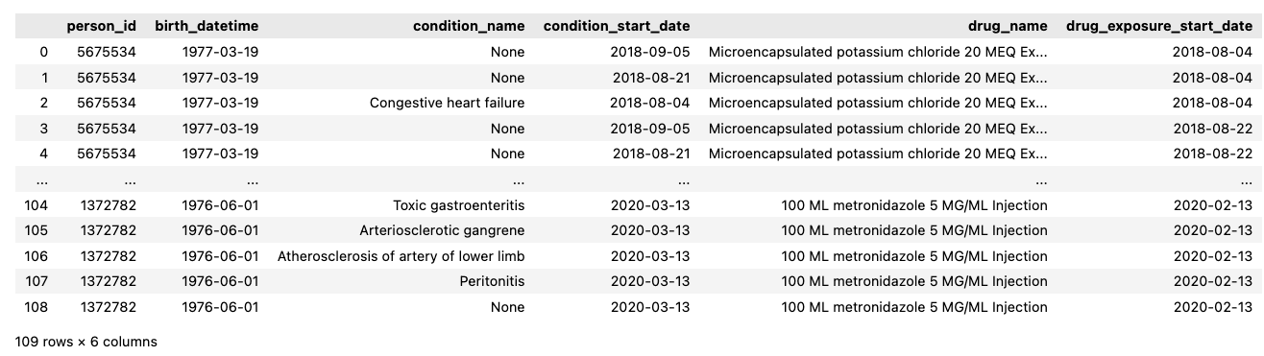
Implementation – DML

Slide 14

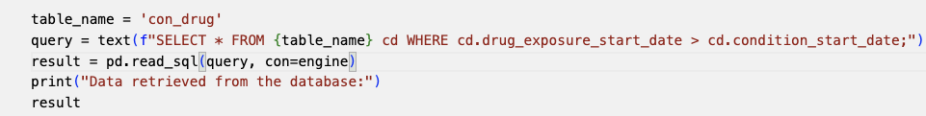
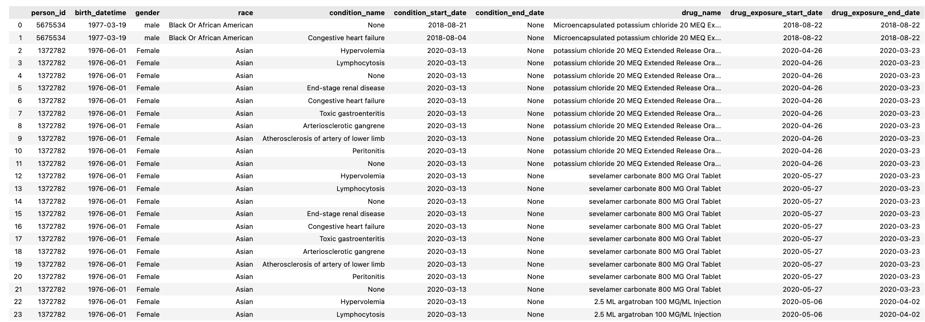

Implementation – DML

Slide 15
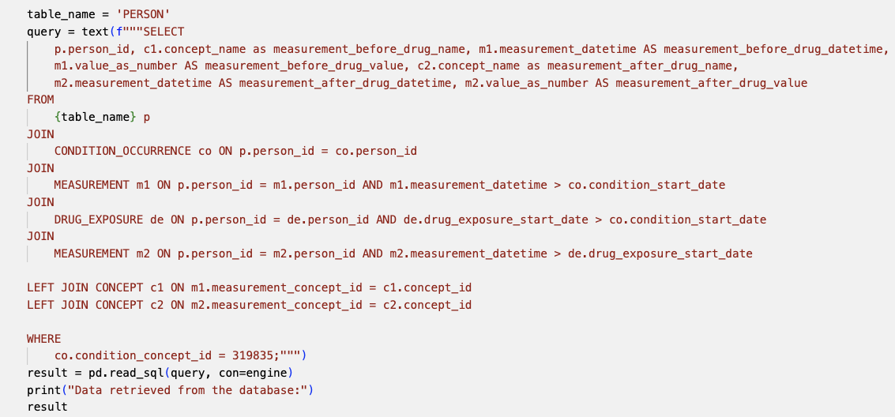


Implementation – DML

Slide 16
Results
TABLE_NAME | Cols | Patients | Concept
Person | 19 | 789,000+ | 8
Procedure_Occurrence | 14 | 242,580 | 30,328
Visit_Occurrence | 17 | 338,444 | 49
Measurement | 19 | 255,640 | 16,618
Observation | 19 | 139,573 – 1,891 | 5,714
Drug_exposure | 22 | 239,740 | 29,865
Condition_Occurrence | 16 | 254,700 | 25,638
Device_exposure | 15 | 40,937 - 254 | 3,323
Each table has at least 14 different features to cover various aspects
Covers a wide range of patients and medical concepts

Slide 17
Challenges
Security of the data
Generate synthetic data
Generating synthetic data with meaningful information
Explore All of Us [6] and Athena [5] first to understand relationship between data and tables.
Creating DDL following similar schema of Common data model
Get help from GitHub [2]
Amount of the data -> difficulties when performing certain queries
Only keep simple and necessary features of the table

Slide 18
Conclusions
The advantages of all of us:
Patient count and data tables enhance research insights across multiple dimensions.
Concept and data tables unveil complex relationships in clinical data analysis.
Future work:
Figure out more tables to get extra information in the data.
With medical knowledge, generate more meaningful dataset.

Slide 19
References
M. Kazijevs and M. D. Samad, "Deep imputation of missing values in time series health data: A review with benchmarking," Journal of Biomedical Informatics, vol. 2023, Art. no. 104440.
OHDSI/CommonDataModelOHDSI/CommonDataModel. (n.d.). GitHub. Retrieved from https://github.com/OHDSI/CommonDataModel
Atlas – OHDSI OHDSI. (n.d.). Atlas. Retrieved from https://atlas-demo.ohdsi.org/#/home
Athena. (n.d.). OHDSI. Retrieved from https://www.ohdsi.org/athena/
OMOP Database. (n.d.). OHDSI. Retrieved from https://www.ohdsi.org/omop-database/
A. H. Ramirez et al., "The All of Us Research Program: data quality, utility, and diversity," Patterns, vol. 3, no. 8, 2022.

Slide 20
Thank you!
Questions?
Aprill 22, 2024

